Slide 1
Agenda
Singleton
Builder
Prototype
Adapter
Bridge
Composite
Decorator
Façade & Gateway
Proxy
Template Method
Chain of Responsibility
Strategy
Observer
Iterator

Slide 2
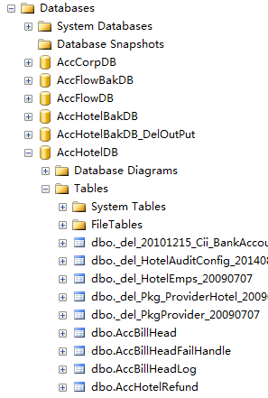
Composite

Slide 3
Thank You!

